Slide 1


NEWGEN SOFTWARE
Reinvent Your Workplace
COPYRIGHT 2016, NEWGEN SOFTWARE INC.
COPYRIGHT 2016, NEWGEN SOFTWARE

Slide 2
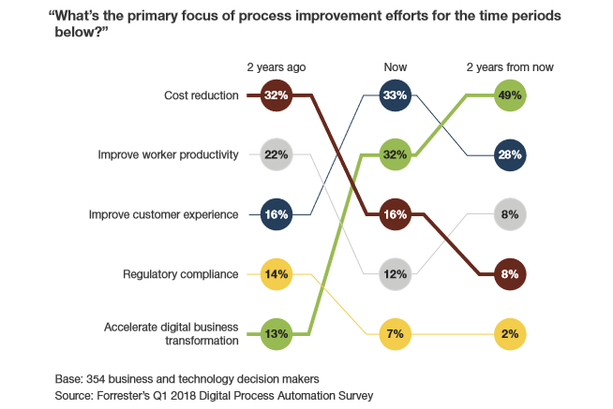
Focus Areas

Slide 3
Cost Reduction – No longer a primary driver

Slide 4
Digital Transformation – The new focus area

Slide 5

What is Digital Transformation?
Digital means Pace of Change
Transformation means how an organization leverage and lead the change
Improve
Operational
Efficiencies
Responding to
Changing Needs
Generate
New Revenue
Streams
Create New
Customer
Experiences

Slide 6
DNA of Digital Maters
The What:
Using Digital Technology to transform the Customer Experience,
Operational Processes & Business Models
Digital Capabilities
The How:
Successful transformations depend as much on how firms manage
digital transformation than solely implementing new Technology
Leadership Capabilities
Source: Book - Leading Digital

Slide 7




Digital Capabilities
Customer Experience
Delight Your Customers
Operational Excellence
Be Faster than The Fastest
Business Model
Make your Business Infinite
Understanding Customer Needs
Creating Value For Customer
Continuous Journey Touch Points
Process Reengineering
Workforce Enablement
Performance Enhancement
Connected Enterprise
Digitally Transformed Business
Futuristic Enhancement

Slide 8
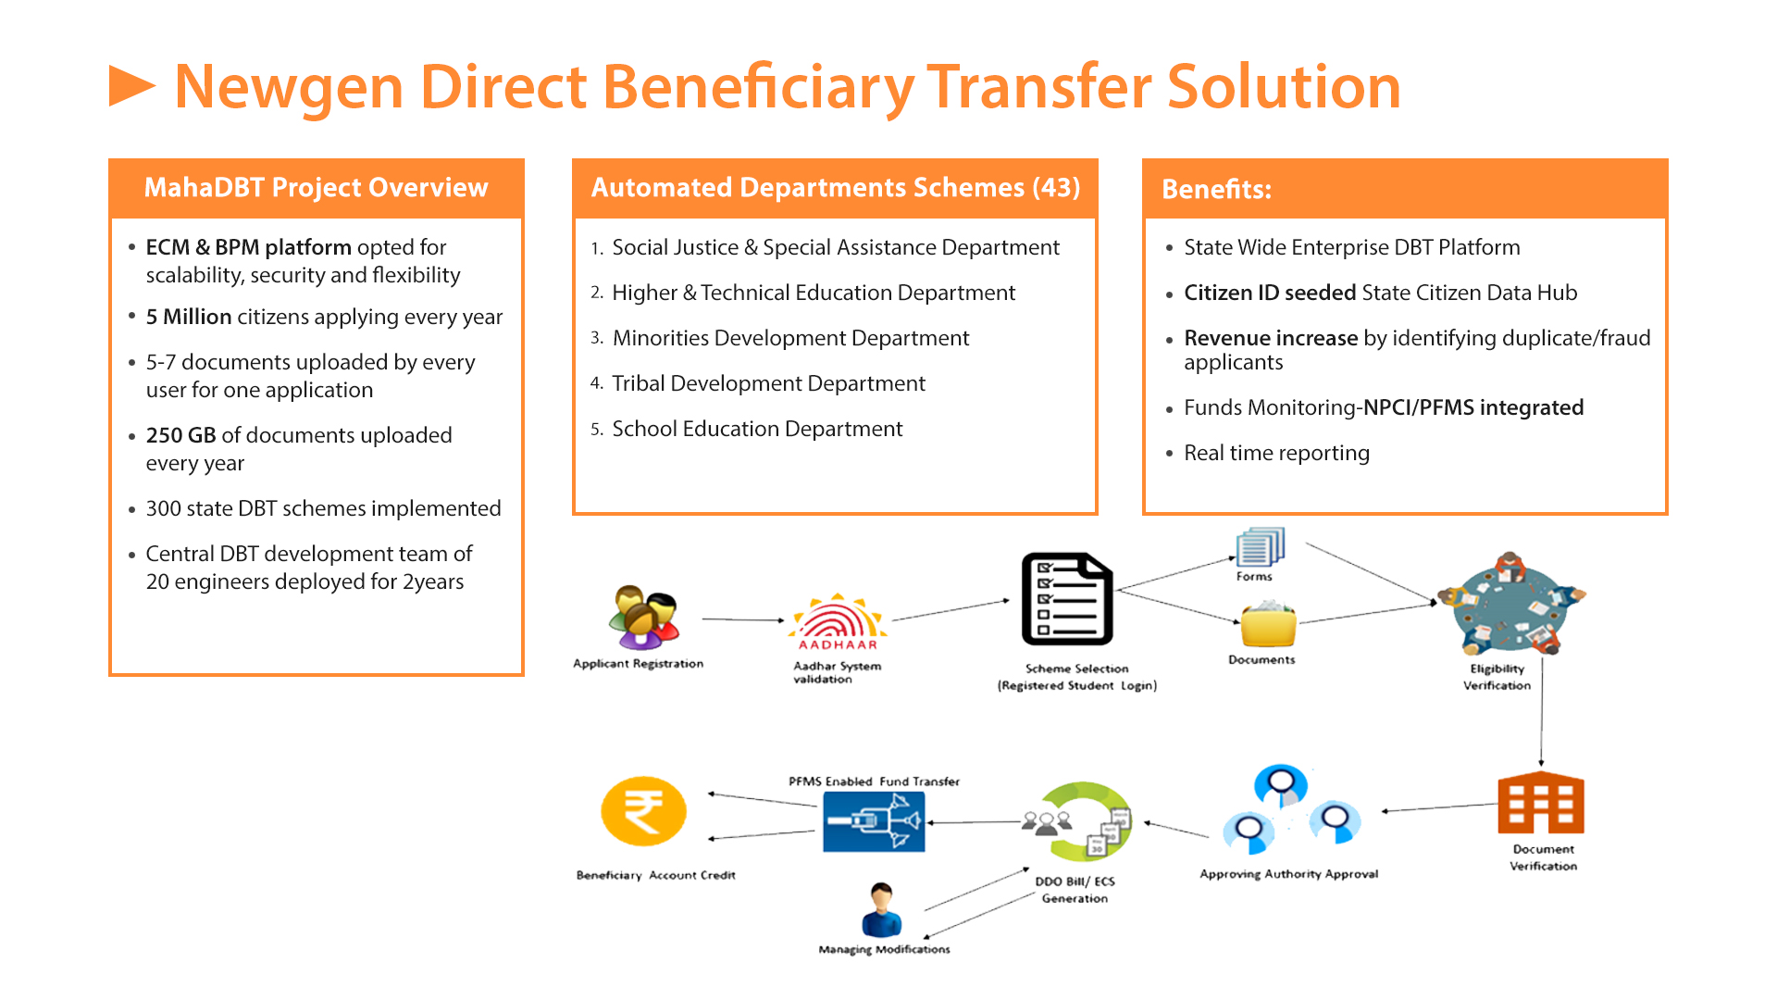
Digital Transformation – Customer Experience/Business Model
Government Challenges
Revenue Leakage
No framework for monitoring
Delays
Insufficient Technical Skills
Legislative and Legal Constraints
Citizen Challenges
A lot of Hassel
No visibility
Chaos

Slide 9







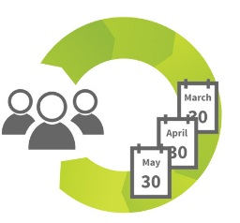




Digital Transformation – Customer Experience/Business Model
Forms
Applicant Registration
Aadhar System validation
Scheme Selection
(Registered Student Login)
Documents
Eligibility Verification
PFMS Enabled Fund Transfer
Beneficiary Account Credit
DDO Bill/ ECS
Generation
Approving Authority Approval
Document Verification
Managing Modifications

Slide 10
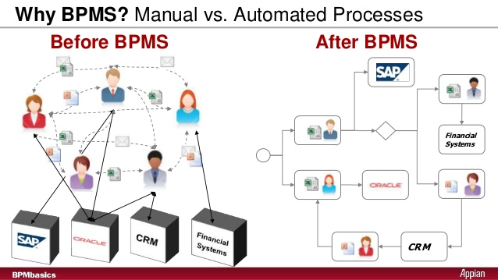



Digital Transformation – Operation Excellence
Discount Credit Note
Recommendation
Financial Concurrence
Lube State Incharge
Finance Officer
Field Officer
Final Approval
State Head
Employee Master
Approval of Note
ED Lube
If credit note >60 days
HO GM(FI)
HO CGM(ILS)
HO GM (ILS)

Slide 11



Digital Transformation – Operation Excellence
Corporate & Operations
Retail & Lube
Aviation & Engineering
HR & Finance
ECM & Portal
Security Contract
MIS Approval for Manpower
Throughput charges approval
Approval for Maintenance/land rental
Approval for opening new airport fuel stations
Approval for development of new ‘Retail Outlet
Approval for Non Fuel Alliances (NFA)
Approval for procurement of Land for New Retail Outlet/Agency
Subsidy Management
Foreign Trainings/Conferences
Training Requests Process (E-Learning process/External Program)
CAR Requesting booking
Re-appropriation of Revenue Budget
Pricing Approvals and Circulars
Discount/Credit Notes
Consumer Pump De/Commissioning
Approvals: Admin/Expenditure etc
Sanction note for Ad-hoc Dealership
Sanction note for LOI/LOA Approval
Document Management
Workflow Management
Knowledge Management
Record Management
Approval for Repairs and maintenance
Existing Systems
Retail System
e-Ledger
Legacy Systems
DB Database
Collaboration
Active Directory
Email & SMS Gateway
Digital Signature
Integration with ERP
Case
Management
Business Process Management
Events
Credential
Management
Processes
Tasks
Analytics Engine
Rules Engine

Slide 13



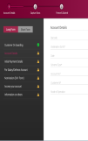


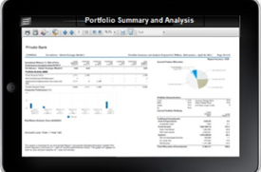
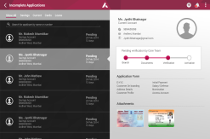





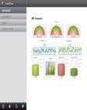


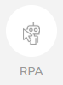


Newgen Product Suite
Content Capture
Processing
Reporting & Monitoring
Customer Communication
Mobile Solution
Collaborative Process Design
Real Time Dashboard
Leading Indicators
Dashboards
Multiple Application Inputs
Indexing
Execution
Approvals
Analytics and ML
Designer
Design Templates
Managed Touch Points
OMNISCAN
iBPS
OMNIOMS
NEMF
Storage In DMS
Long-term Preservation
Record Classification
Retention & Disposition
Physical Tracking
Archival
OMNIDOCS
RECORDS MANAGEMENT

Slide 14








Newgen at a Glance
New Delhi
Mississauga, ON
London
New Delhi
Philippines
Mississauga, ON
London
Mumbai
Kolkata
Mumbai
Kolkata
540+ Active
Customers
66
Countries
San Francisco, California
Chennai
Tampa, Florida
Bengaluru
Dubai
20% CAGR
2,800+
Employees
Washington D.C.
Dubai
Australia
Singapore
Global Offices
HQ
43%
29%
28%
17
Verticals
APAC
EMEA
44 Patent Filing
(11 Patents Granted)
USA
FY19 Revenue Split by Geography

Slide 15

Analyst Recognitions
“ A Strong Performer” in “ECM Content Platforms” Wave™ Report, Q3 2019
“A Strong Performer” in “Digital Process Automation for Wide Deployments” Wave report, Q1 2019
“A Leader” in “Cloud-Based Dynamic Case Management” Wave report, Q1 2018
“A Strong Performer” in “Customer Communication Management” Wave report, Q2 2016
A “Challenger” in Magic Quadrant for Content Services Platforms, 2019
A “Niche Player” in Magic Quadrant for Intelligent Business Process Management Suites, 2019
A “Niche Player” in Magic Quadrant for Customer Communication Management, 2017
A “Challenger” in Magic Quadrant for BPM Platform- Based Case Management Framework, 2016
Critical Capabilities for Content Services Platforms, 2019
Critical Capabilities for Intelligent Business Process Management Suites, 2019
Critical Capabilities for BPM-Platform-Based Case Management Frameworks, 2016
  Rated in Top 4 for all case management styles

Slide 16
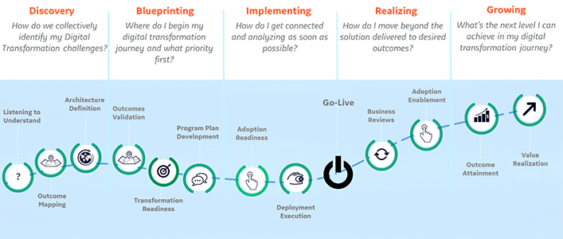
Our Contribution in your Digital Transformation Journey
DIGITAL TRANSFORMATION JOURNEY STAGES
Newgen Can Help you with
Strategic Digital Transformation
Recommendations on Approach
Process Evaluation
Process Discovery
Key Business Process Implementation
Detailed Study
Key Process Modelling
Workshops and Training

Slide 17
OPEN FOR QUESTIONS
9711597158/9810308921

Slide 18
INDIA
Corporate Office
A-6, Satsang Vihar Marg
Qutab Institutional Area
New Delhi -110 067, India
Tel : +91-11-4077 0100, 2696 3571
Fax : +91-11- 2685 6936
corpmktg@newgensoft.com
APAC - SINGAPORE
Newgen Software Technologies Limited
Off No: 314, Building No: 3
P O Box. 500297, Dubai Internet City
Dubai, UAE
Tel : +971 44541365
Fax :+971 44541364
emea@newgensoft.com
AMERICAS
Newgen Software Inc.
Washington DC Metro Area
1364 Beverly Road, Suite 300
McLean, VA 22101
Tel : +1-703-749-2855, +1-703-439-0703
Support Hotline : +1-800-499-5074
usa@newgensoft.com
Newgen Software Inc.
8270 Woodland Center Boulevard
Tampa, Florida – 33614
Tel : +1-813-769-3575
Fax : +1-905-361-6401
usa@newgensoft.com
EMEA - DUBAI
Newgen Software Technologies Pte Ltd.
30, Raffles Place # 17-38
Chevron house, Singapore 048622
Tel : +65 6221 8432
Fax : +65 6221 6923
asiapac@newgensoft.com
Thank you
www.newgensoft.com
Notes:
woodapple

